Slide 1

Time Series Forecasting of Precious Metal Prices: ARIMA & Exponential Smoothing Models
An Empirical Analysis (January 2018 - November 2023)
Creator: Zhi Zheng & Marckenrold Cadet

Slide 2
Introduction
Forecasting precious metal stock prices is crucial in today's interconnected global economy. It informs decisions of investors, policymakers, and industry leaders.
In this analysis, we focus on five key commodities: Gold, Silver, Copper, Platinum, and Palladium. Each plays a vital role in various sectors, from technology to jewelry, influencing market dynamics extensively.
Accurate forecasts enable stakeholders to make informed decisions. For instance, investors rely on price predictions for portfolio management, while policymakers use these forecasts to understand economic trends and formulate strategies.

Slide 3
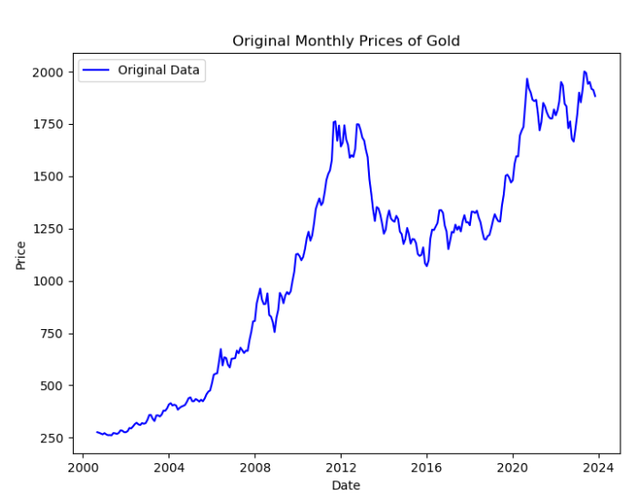
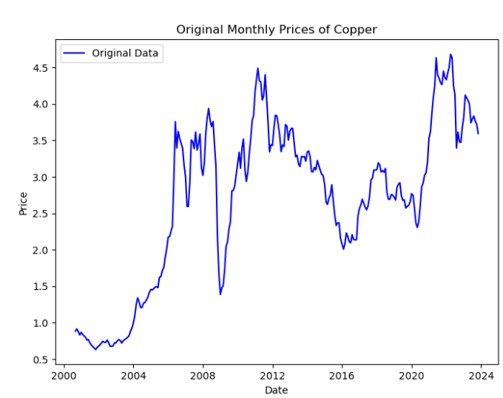
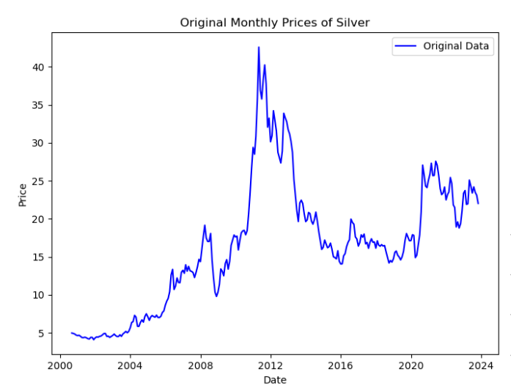
Exploratory Data Analysis (EDA)
Throughout history, precious metals has been seen as a special and valuable commodities.
All precious metal stock price have been volatile and dynamic overtime.
Implicating the data is not stationarity for all the precious metal price.

Slide 4
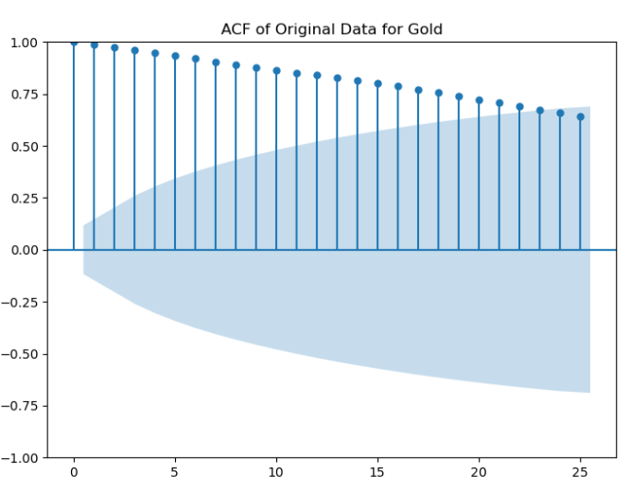
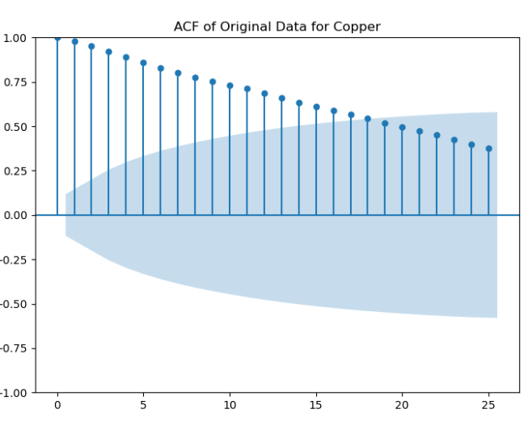
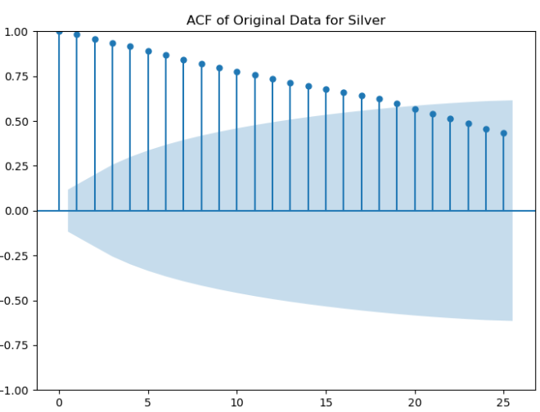
Methodology - Part 1: Analysis of Stationarity in Commodity Prices
Stationarity is a prerequisite for time series forecasting models, ensuring consistent mean and variance over time.
The Augmented Dickey-Fuller (ADF) test is used to confirm stationarity, checking for a unit root in the series.
The ADF test results for the original data of Gold, Silver, Copper, Platinum, and Palladium all show p-values significantly above the 0.05 threshold, suggesting non-stationarity.“
After applying a first difference to the data, the ADF test results show much lower p-values, indicating rejection of the non-stationarity null hypothesis for all commodities.

Slide 5
Methodology - Part 2: ADF Testing and Differentiating
The original data p-values are all greater than 0.05, indicating that all the data are non-stationary. After differentiating all five of the precious, all the data became stationary with the p-value less than 0.05.
Precious Metal | Original Data p-value | Differenced Data p-value
Gold | 0.7903 | 8.21e-26
Silver | 0.3873 | 3.47e-08
Copper | 0.2521 | 2.69e-05
Platinum | 0.2972 | 1.73e-11
Palladium | 0.3569 | 0.0003

Slide 6
Modeling
Naïve Model: Naïve model is the simplest form of forecasting, serving as the baseline for our project to compare performance. The naïve model assumes the most recent data observation to be the best predictor for the forecasting values.
ARIMA Fundamentals: ARIMA models, denoted by (p, d, q), are foundational for capturing the autoregressive and moving average behaviors in non-seasonal time series data.
SARIMA for Seasonality: SARIMA, an extension of ARIMA, includes seasonal components (P, D, Q, s) to specifically address and model the seasonal variations in time series data.
Exponential Smoothing Dynamics: Exponential Smoothing models apply decreasing weights to past observations and incorporate trend and seasonal adjustments for a more nuanced forecast.

Slide 7
Modeling and Validation: : Navigating Through Time Series Forecasting
Modeling Journey:
Validation Approach:
Beginning with Naïve Model:
Set the baseline for performance using data from Jan to Mar 2023.
Analyzed commodities: Gold, Silver, Copper, Platinum, Palladium.
Provided key metrics: RMSE, MAE, MSE, MAPE.
Advancing to VAR Model:
Explored data from Jan 2018 to Dec 2022.
Focused on multivariate relationships in commodity markets.
Encountered challenges in capturing market volatility accurately.
Assessing Model Accuracy:
Compared Naïve model baseline with advanced model outputs.
Evaluated performance based on standard forecasting metrics.
Insights Gained:
Identified the need for more refined models.
Recognized each commodity's unique market behavior.

Slide 8
Model Tuning: Navigating Through Time Series Forecasting
Enhancing Model Precision:
Auto ARIMA Implementation:
Utilized the pmdarima library for automated parameter selection.
Aimed to find statistically optimal models for precision.
Exponential Smoothing Tuning:
Using for loop to adjusted parameters to capture trends and patterns.
Sought to improve forecasts beyond the baseline and VAR models.
Commodity | Best Model | RMSE | MAPE
Gold | Exponential Smoothing | 58.96 | 2.72%
Silver | ARIMA | 1.59 | 6.13%
Copper | Exponential Smoothing | 0.20 | 4.66%
Platinum | ARIMA | 58.81 | 5.45%
Palladium | ARIMA | 264.94 | 15.75%

Slide 9
Results and Discussion
Model Performance:
Naïve Model set the baseline; effective for initial insights.
VAR Model revealed complexities but lacked precision.
Auto ARIMA & Exponential Smoothing significantly improved accuracy.
No 'one-size-fits-all' model; effectiveness varied per commodity.
Auto ARIMA critical for optimal parameter selection.
The study highlights the dynamic and complex nature of commodity markets.
A multi-model approach is essential for accurate forecasting in financial markets.
These insights pave the way for more tailored and advanced forecasting techniques in the future.

Slide 10
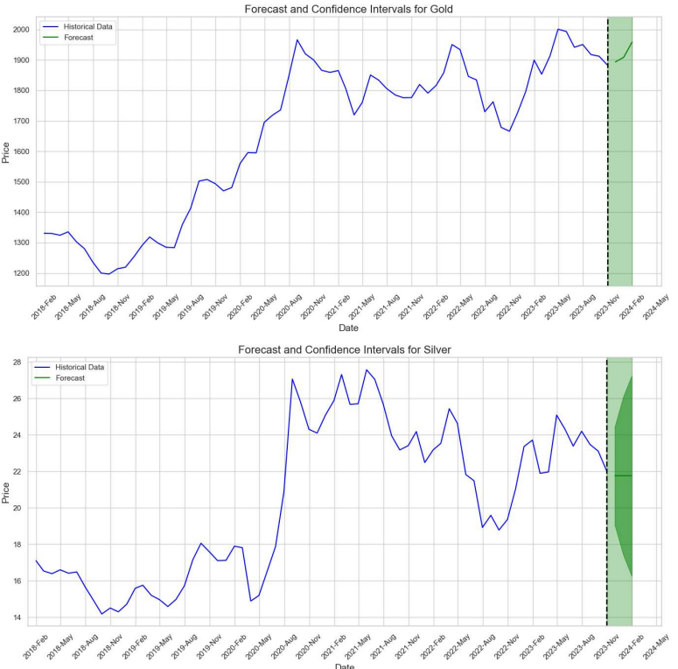
Forecasting

Slide 11
Conclusion and Future Work
The exploration of time series forecasting in commodity markets revealed significant insights.
Varied model performance underscores the unique nature of each commodity:
Exponential Smoothing showed strength for certain commodities like Gold and Copper.
ARIMA models were better suited for Silver, Platinum, and Palladium.
The study emphasizes the need for a tailored approach, adapting the model to the specific characteristics of each commodity.
Integrating Advanced Techniques: Machine Learning Integration & AI for Trend Analysis
Dataset Enrichment: Incorporating Economic Indicators & Market Sentiment Analysis
Dynamic Modeling: Real-Time Data Analysis & Adaptive Models

Slide 12
Questions?

